Slide 1









SMART VEHICLE BATTERY
Presented by
Mohan R

Slide 2
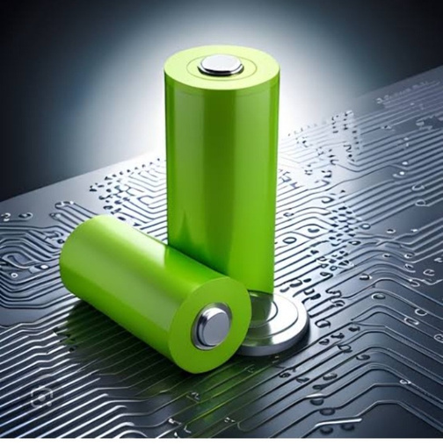

INTRODUCTION
#The world is going eco friendly.
#Electrical bikes are using lithium ion battery
#Smart grid system use.
# It is reduced the temperature, increase the life time and low power consuming.

Slide 3
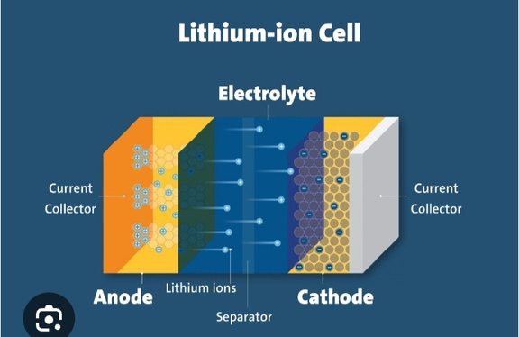
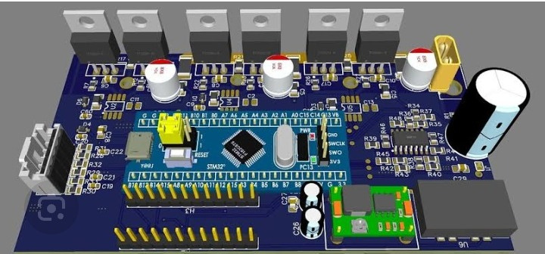
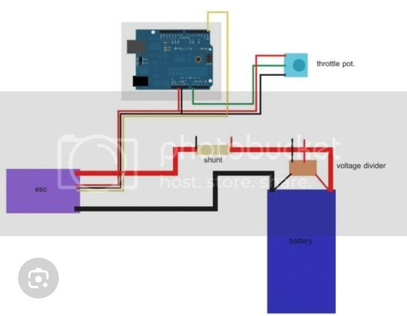
PROJECT GOALS
1.
Lithium ion battery is easy to charge but it is quickly heat
2.
Using smart grid system and Arduino.
It use two separate lithium ion battery.

Slide 4
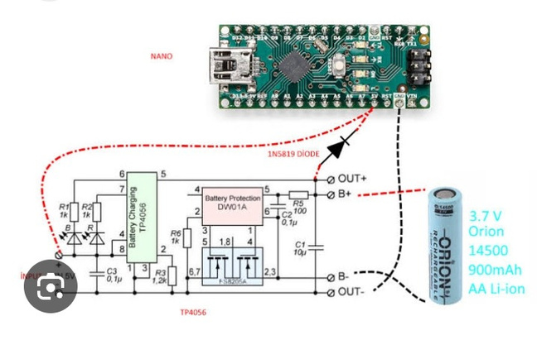
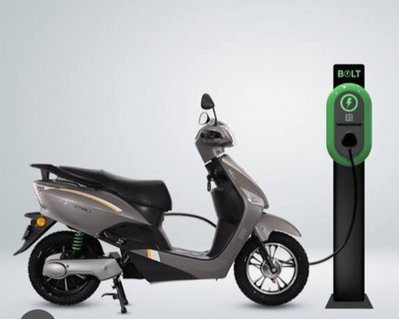
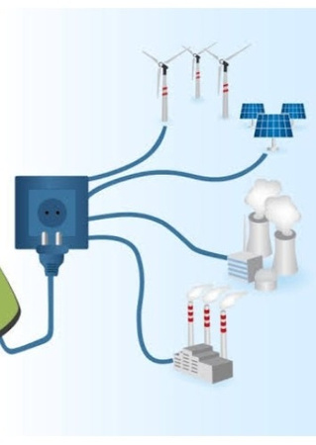
DISCUSSION
The battery connected to smart grid system.
smart grid system control the what battery using in running time .
Arduino is programed in how much charge available in battery.
Arduino is connected battery and smart grid system.

Slide 5
PROGRAM FOR ARDUINO
def calculate_battery_level(voltage, min_voltage, max_voltage):
"""
Calculate the battery level percentage based on the battery voltage.
Args:
voltage (float): The current voltage of the battery.
min_voltage (float): The voltage at which the battery is considered fully discharged.
max_voltage (float): The voltage at which the battery is considered fully charged.

Slide 6
Returns:
float: The battery level as a percentage.
"""
# Ensure that the voltage is within the expected range
if voltage < min_voltage:
return 0.0
# Battery is completely discharged
elif voltage > max_voltage:
return 100.0
# Battery is fully charged

Slide 7
# Calculate the percentage of charge based on the voltage range
battery_percentage = ((voltage - min_voltage) / (max_voltage - min_voltage)) * 100
return battery_percentage
# Example usage
min_voltage = 3.0
# Minimum voltage for a discharged battery
max_voltage = 4.2

Slide 8
# Maximum voltage for a fully charged battery
# Simulate a current battery voltage reading
current_voltage = 3.7
battery_level = calculate_battery_level(current_voltage, min_voltage, max_voltage)
print(f"Battery Voltage: {current_voltage}V")
print(f"Battery Level: {battery_level:.2f}%")
Output:
Battery Voltage :3.7V
Battery level :58.33%

Slide 9
ANALYSIS
#Input 220V in charging.
#output 36V in recived in two batteries.
#it is increasing the travel time.
# completely reduced the heat.
#it is increasing cost of battery

Slide 10
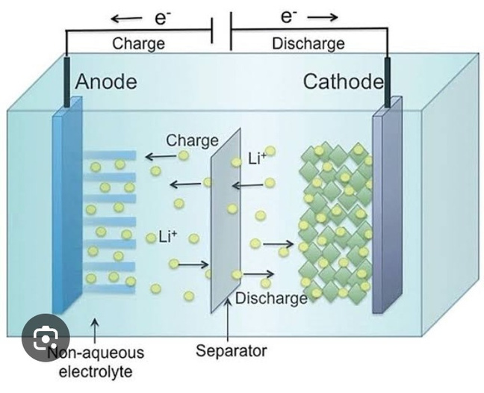
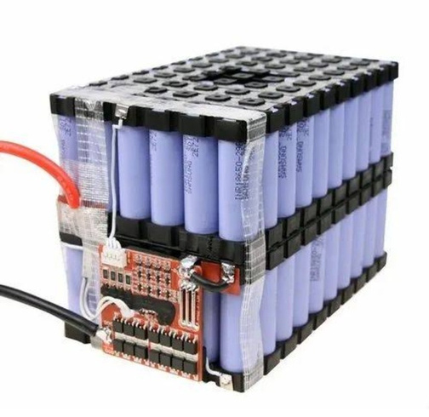
RESULT
The reduce the heating in traveling time.
life time increase.
quick charging.
Charge level stable.

Slide 11
CONCLUSION
Using smart grid system in lithium ion battery, it is provided more efficient in lifetime.
increase the life time performance.
Arduino is provided how much charge available.

Slide 12
THANK YOU

